Slide 1
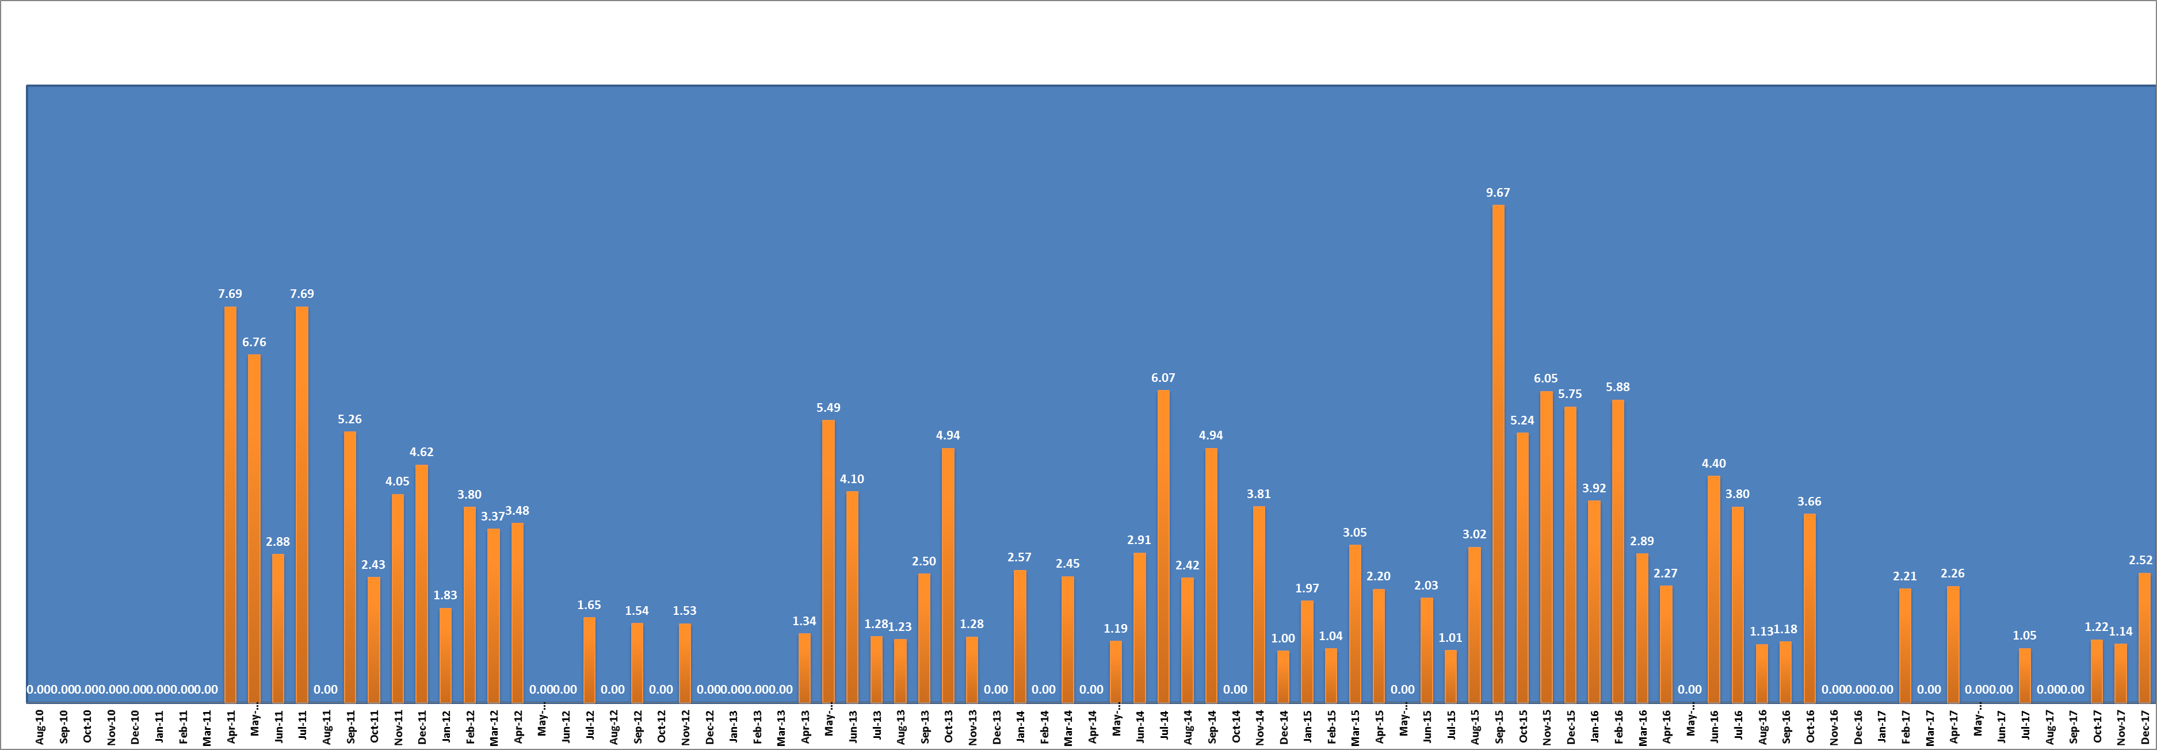
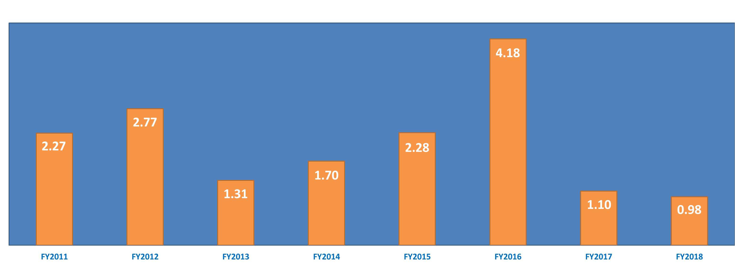
Reducing CDI at our Long Term Acute Care Hospital
Brenda Heon, BSN, RN & Tara Beuscher, DNP, RN
C. diff Rate/1000 Pt. Days by Month Aug 2010 – December 2017
Interventions for Rise in C. diff Rates
All patients on Contact Precautions
December 2010 – December 2017
LTACH Patients are at high risk for C. diff
Longer hospital stay (average 28 days)
Often Immunocompromised
Many have Long-term antibiotic usage
Many have history of multiple hospitalizations
2014
March: Probiotic yogurt offered to patients as an alternative to Lactobacillis GG
October: Initiated copper infused linen
December: Initiated Doorside Clinical rounding 3x/week
2015
August: C.diff action plan
October: Competency validation on handwashing
2016
March: Larger C.diff signs in room
March: Changed ATP standards to 75 down from 100
May: Bleach all rooms twice weekly (EVS)
July/August: All beds replaced due to mechanical issues
2017
January: Switched to Lab ID of C.diff vs. clinical dx. (NHSN)
June: Initiated bed deck covers
December: All beds replaced due to system wide upgrade
C. diff Rate/1000 Pt. Days by Fiscal Year
71%
C. diff Action Plan
Proactive isolation until cleared
Antibiotics reviewed for indication and duration of use
Bleach cleaning for team station and common areas including computer keyboards and telephones
Enhanced cleaning of shared patient equipment between rooms
Clear delineation of roles for cleaning (HUCs vs. EVS)
Utilize when C. diff is above target goal
Reduction
FY2017
Lessons Learned:
Reduction in CDI correlated with environmental
factors with bed replacement.

